Slide 1
Credit Risk Analysis Case Study
Submitted by: Nihala Mol Vadakkethodi

Slide 2


Project Scope
The main objective of this Project is to minimize the risk and maximize the profit of the bank.
Bank has to make a decision on credit risk based on the applicant’s profile to minimize the loss from the bank's Perspective.
PROJECT REQUIREMENTS
Assessing the risk
Customer Demographics Analysis: Assessing the risk based on various customer demographics
Customer Account Analysis: Assessing the risk based on customer account details
Credit Amount Analysis: Understand the distribution of credit amount
Analysis of Credit Purposes: Exploring the purposes of the credit

Slide 3
About Dataset
The Data Source for the current project is taken from the Kaggle repository.
The original dataset contains 1000 entries with 20 categorial/symbolic attributes prepared by Prof. Hofmann. In this dataset, each entry represents a person who takes a credit by a bank. Each person is classified as good or bad credit risks according to the set of attributes.
It is almost impossible to understand the original dataset due to its complicated system of categories and symbols. Thus, I wrote a small Python script to convert it into a readable CSV file. Several columns are simply ignored, because in my opinion either they are not important or their descriptions are obscure.

Slide 4
About Dataset
The selected attributes are:
1. Age (numeric)
2. Sex (text: male, female)
3. Job (numeric: 0 - unskilled and non-resident, 1 - unskilled and resident, 2 - skilled, 3 – highly skilled)
4. Housing (text: own, rent, or free)
5. Saving accounts (text - little, moderate, quite rich, rich)
6. Checking account (numeric, in DM - Deutsch Mark)
7. Credit amount (numeric, in DM)
8. Duration (numeric, in month)
9. Purpose (text: car, furniture/equipment, radio/TV, domestic appliances, repairs, education, business, vacation/others)

Slide 5
Approach
EDA USING PYTHON
DATA VISUALIZATION USING TABLEAU
MACHINE LEARNING MODEL

Slide 6
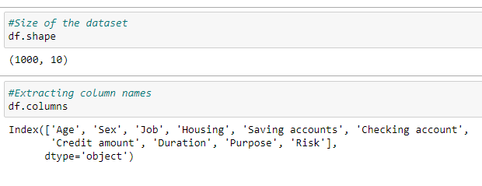
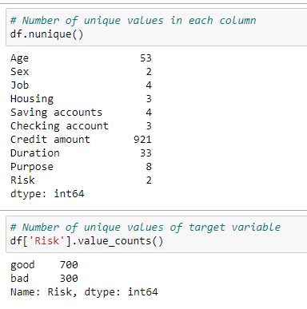
1.EDA Using Python
1.1 Data Understanding
Number of rows = 1000
Number of columns = 10
Columns of the data =' Age', 'Sex', 'Job', 'Housing',
'Saving accounts', 'Checking account', 'Credit amount',
'Duration', 'Purpose', 'Risk
Number of unique values in each column
Age 53 Sex 2 Job 4 Housing 3 Saving accounts 4 Checking account 3 Credit amount 921 Duration 33 Purpose 8 Risk 2
Number of unique values of target variable
good 700 bad 300

Slide 7
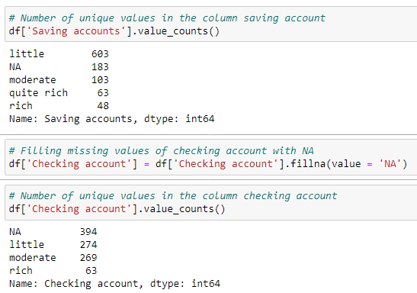
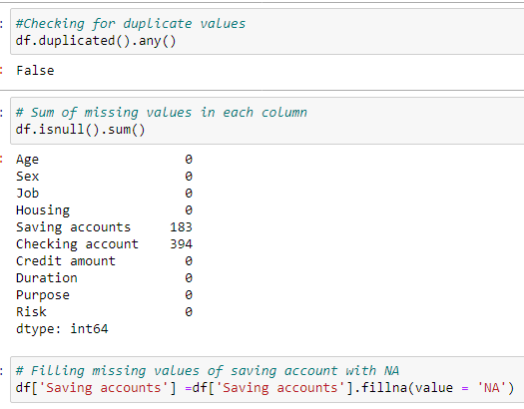
1.EDA Using Python
1.2 Data Cleaning
There is no duplicate values in the dataset
Missing values present are :-
Saving account 183 Checking account 394
Filled the missing values of saving account and checking account with 'NA'
Found the number of unique values in the column saving account. Which are :-
little 603 NA 183 moderate 103 quite rich 63 rich 48
Found the number of unique values in the column checking account. Which are :-
NA 394 little 274 moderate 269 rich 63

Slide 8
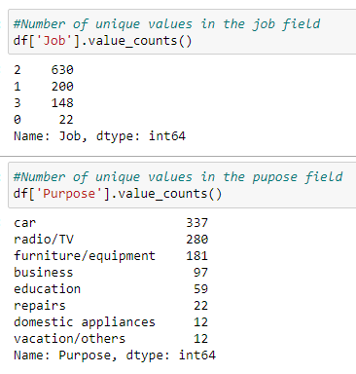
1.EDA Using Python
Found the number of unique values in the job field. That are :-
2 630 1 200 3 148 0 22
Found the number of unique values in the purpose field. That are :-
car 337 radio/TV 280 furniture/equipment 181 business 97 education 59 repairs 22 domestic appliances 12 vacation/others 12

Slide 9

2. DATA VISUALIZATION
USING PYTHON AND TABLEAU

Slide 10
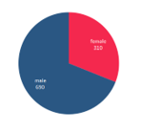
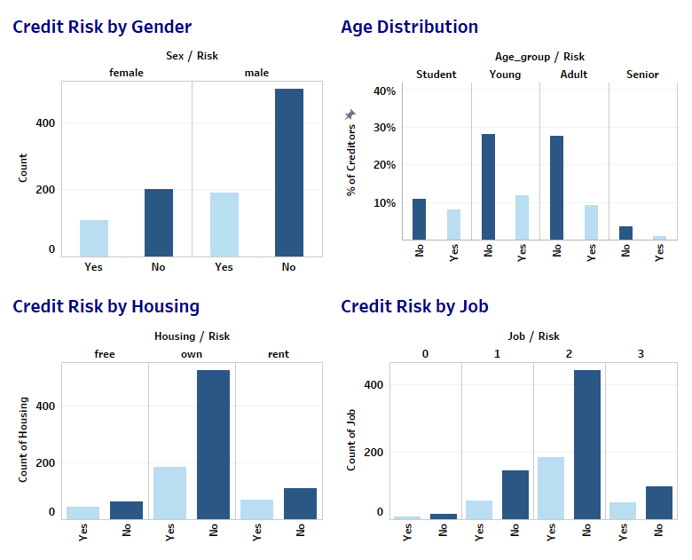
2.1. Customer Demographics Analysis
Gender Distribution
Gender Distribution: Male customers are double than that of Female Customers to take the credit
35% of the female customers are risky while only 28% of male customers risky
People with "own house" emerges as the leading customers for credit, among which only Quarter of them is risky.
Among creditors with rent and free 40% are risky
"Students " are is risky creditors and "Adults" are less risky creditors
While youngsters and senior people comes in between by having about 28% are risky among them
Job of creditors does not show a huge impact on risk ,even though job with 3 is having more riskier than other job with by a small percentage

Slide 11
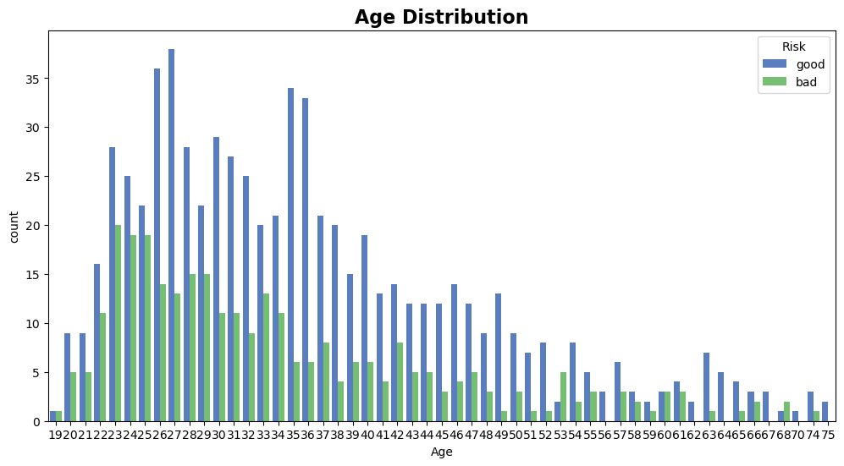
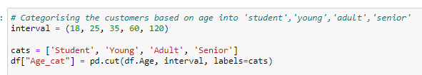
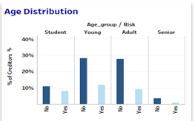
2.1. Customer Demographics Analysis
Contribution of each age to risk is not relevant therefore we categorical age as above
Categorizing the customers based on age into 'student', 'young', 'adult', 'senior'.

Slide 12
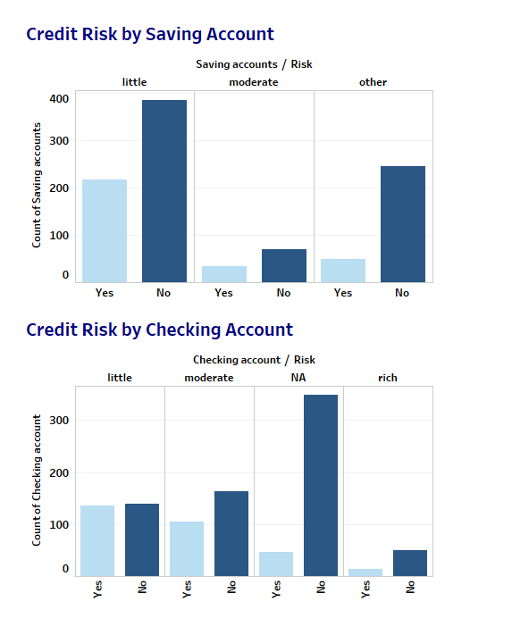
2.2. Customer Account Analysis
Savings and checking account who are rich and marked as NA are less riskier
Checking account which is little is higher risk with half of them
Checking account with 40 % moderates are risk
Saving account with little and moderates are on an avg 34% risk

Slide 13
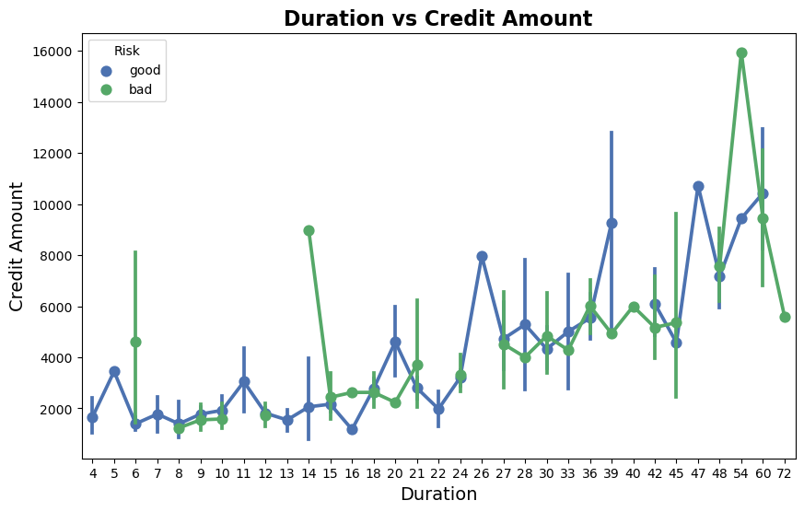
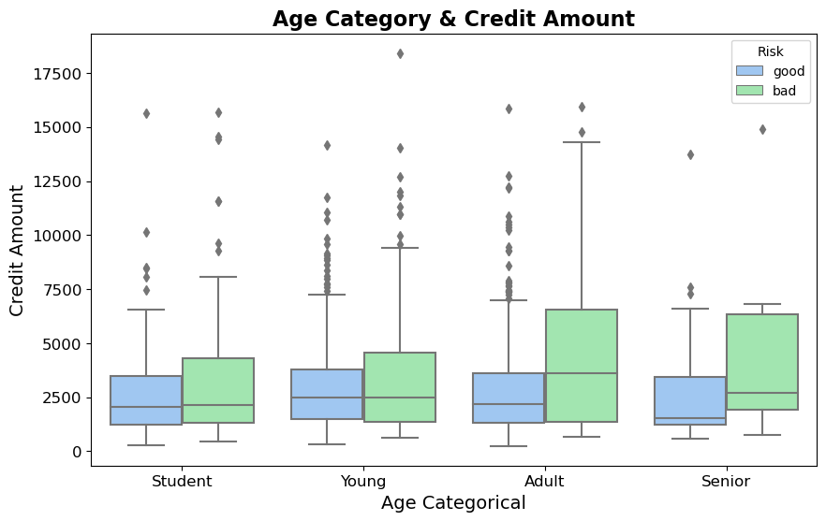
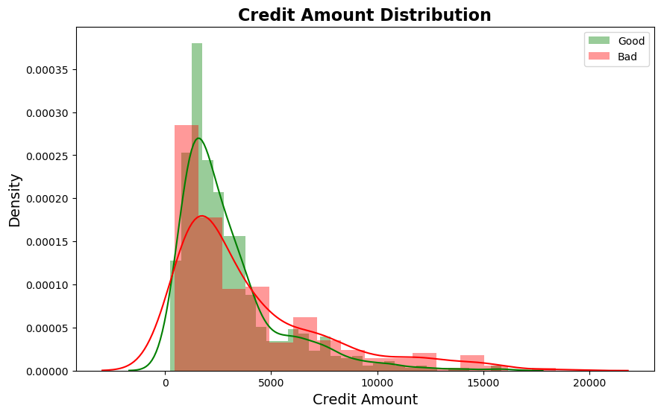
2.3. Credit Amount Analysis
Credit amount is distributed between 500 to 19k
A huge number of creditors are taking amount between 500 to 5k
There are also significant creditors taking in amount between 5.5kto 13k .
A slight number of creditors take credit between 13.3k to 16.6 k
Only rare amount of creditors take credit more than 17 k which is between 18k to 18.8k
Credit amount and Risk
From the graph it is clear that it is safer to give credit amount below 4k upto a certain limit
For giving credit amount greater than 4k it is slightly risky ,we have to consider so many factors for that
Also it is clear that it is riskier to credit an amount more than 11k
From the box chart we can summarize that adults and seniors are taking higher amount of credit and are not paying back
There is no any clear inference regarding risk related to relation

Slide 14
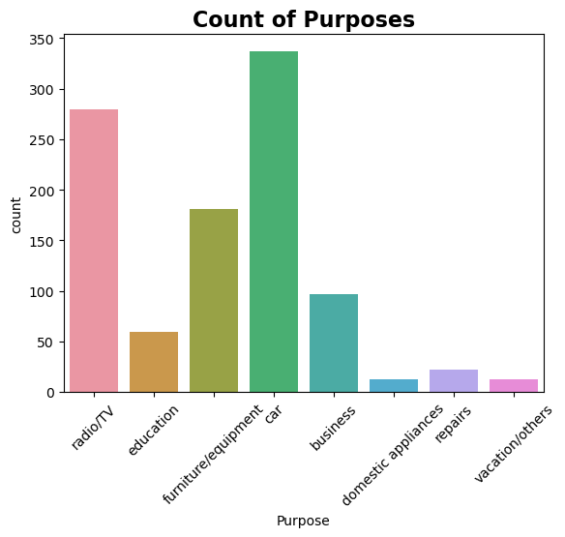
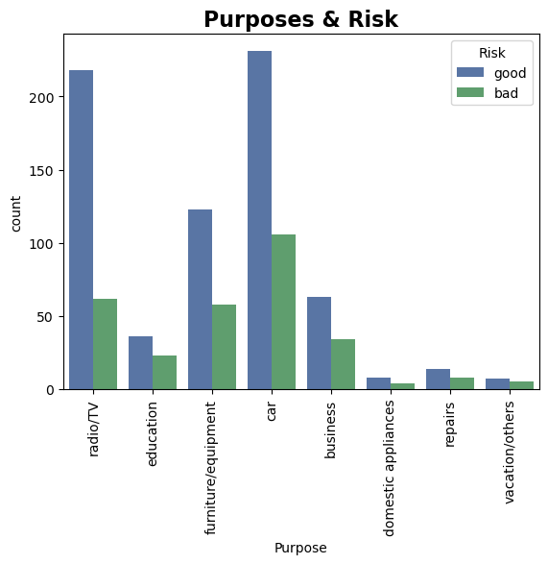
2.4. Analysis of Credit Purposes
Car is the most demand purpose for creditors followed by radio/TV, then furniture/equipment
Least demand is for domestic appliances and then for vacation/others
More credit risk is for the vacation/others (41%)
Least risk is for the radio/TV (22%)
Credit risk for the rest of purposes are education : 38%, business: 35%, repair : 34%, domestic appliances : 33%, car : 31%

Slide 15
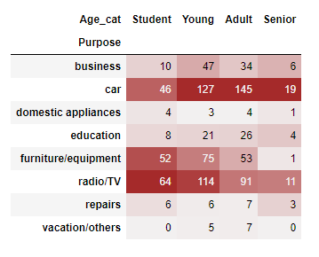
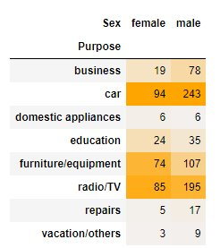
2.4. Analysis of Credit Purposes
Students highest demand purpose is for radio/tv followed by furniture/equipment and then the car
Given students didn't contribute for the purpose of vacation/others credit
Highest demand purpose for adults and youngsters is car and their least demand purpose is domestic appliances.
Seniors Creditors highest demanded purpose is also car and their lowest demanded purpose is vacation/others

Slide 16
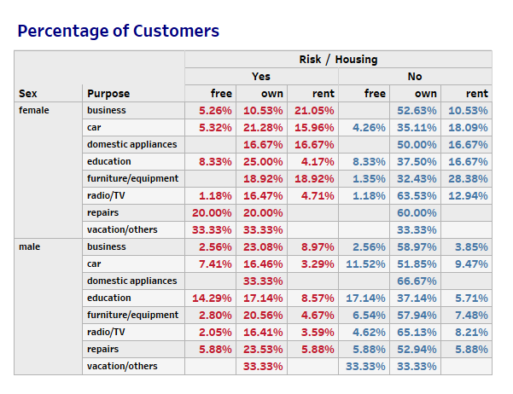
2.5. Percentage of customers to the risk
Female who are free living taking credit for the purpose of repairs, vacation/others and business is a risk creditor
Customers who have "own" house is much safer for granting credit

Slide 17
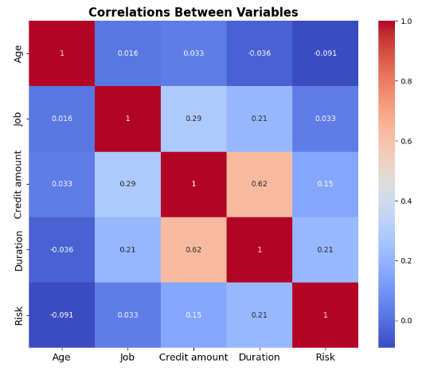
2.6. Correlation Between Variables
Replaced the values in the risk field , 'good' with 0 and 'bad' with 1
From the chart we can summarize that age and job have no any impact on risk.
Also the credit amount and duration are only slightly related to risk, or can say no any significant effects on risk
Also when credit amount increase duration also increases

Slide 18
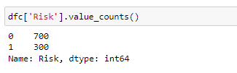
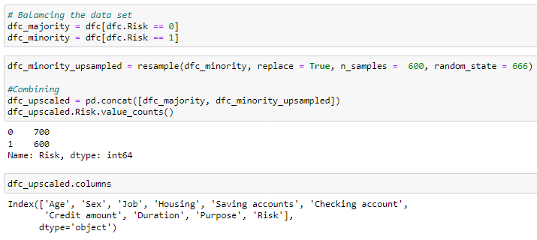
3. Machine Learning
Data preparation
The unique values in the field of risk is unbalanced, ie
Number of Good risk , 0=700
Number of bad risk, 1=300
We have to balance the data set by the technique known as unsampling minority
After the process the upscaled data set contains
Number of Good risk , 0=700
Number of bad risk, 1=600

Slide 19
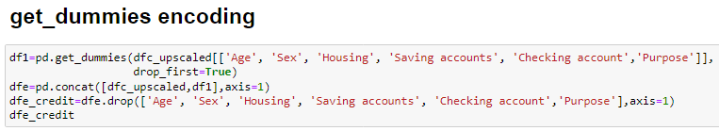
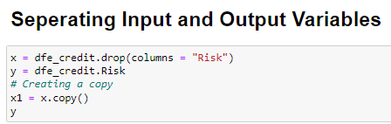
3. Machine Learning
Feature Engineering
As the machine learning support only numerical values we have to convert categorical values into numerical values
Here to convert into numerical values we are using get_dummies encoding
Now separate the data set by assigning the input variables to x and target variable to y
At this point we are ready to begin the model creation

Slide 20
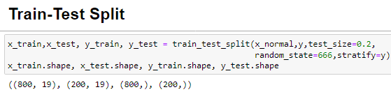
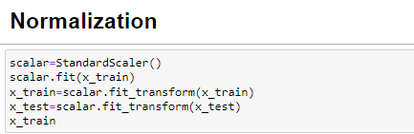
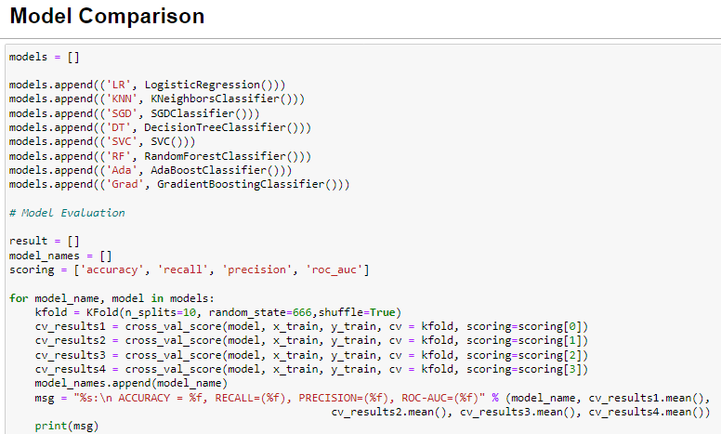
3. Machine Learning
Train-Test Split
Split the data into train data and test data in which test data size is 30%
Now normalize the data set using the function StandardScalar()
Model Comparison
Now compare the model to select the best suitable model
So compared 8 models which are :
Logistic Regression
K Neighbors Classifier
SGD Classifier
Decision Tree Classifier
SVC
Random Forest Classifier
AdaBoost Classifier
Gradient Boosting Classifier

Slide 21
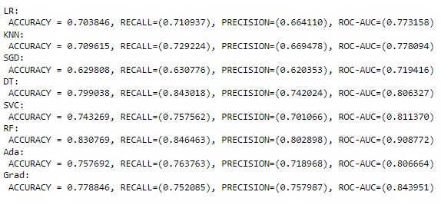
3. Machine Learning
Best Model
The Analytical comparison is performed initially, to assess which Models fare well in making accurate predictions. In doing so, several classification Techniques are compared.
The model should perform better than a base model i.e., the one with 70% and above accuracy. Also, recall should be high because from a Business point of view 'False Negative's' i.e., Fraudulent transactions classified as Non-Fraudulent will be more costlier to the Bank.
As a result we choose Logistic Regression as the best model
The reasons for choosing 'Logistic Regression' over other Techniques is as below: - Simplicity. - Explainability. - Accuracy, Recall and ROC-AUC is comparable to Ensemble Methods.

Slide 22
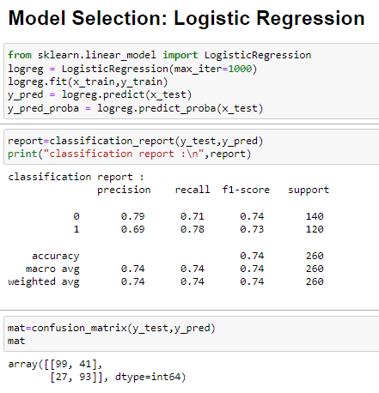
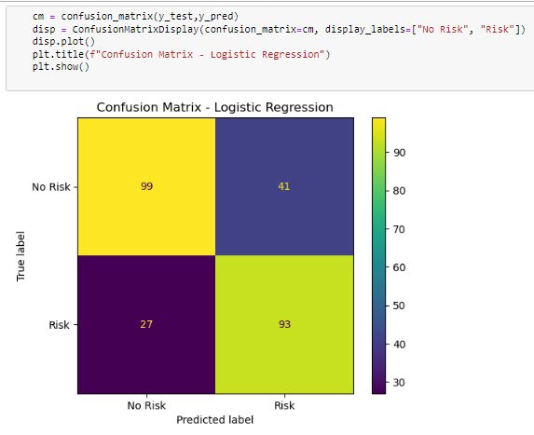
3. Machine Learning
Logistic Regression – Best Model
Performed the logistic regression and predicted the risk, also generated the classification report and confusion matrix
Confusion matrix give insights into whether the predicted values is true positive ,true negative false positive or false negative
True positive means predicted risk matches the actual risk
True negative means predicted not risk is really the not risk
False positive means predicted risk is really not risk
False negative means predicted not risk is really risk

Slide 23
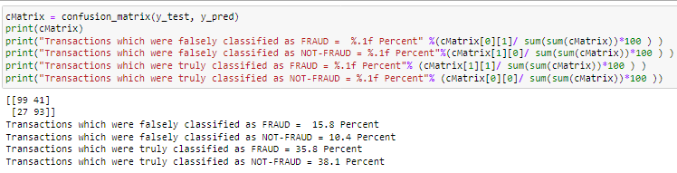
3. Machine Learning
From the confusion matrix the inferences got are :
Transactions which were falsely classified as FRAUD = 15.8 Percent Transactions which were falsely classified as NOT-FRAUD = 10.4 Percent Transactions which were truly classified as FRAUD = 35.8 Percent Transactions which were truly classified as NOT-FRAUD = 38.1 Percent

Slide 24

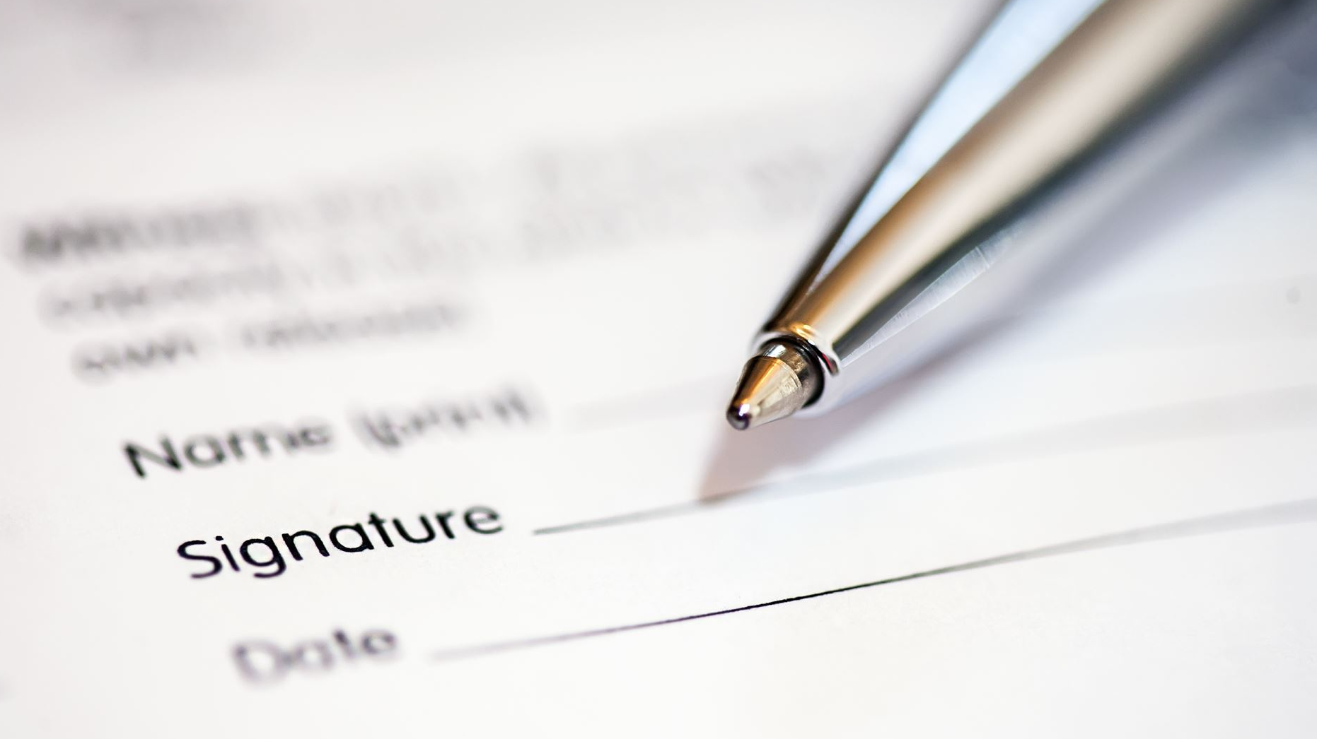



Final Summary and Conclusion

Slide 25
Decisive Factor Whether an Applicant will be not be Credit Risk
Age : Adults are more safe people to give credit
Sex : Men are relatively higher on repay, so safe to give credit
Job : Job doesn't have much effect on Credit Risk
Saving Account : Rich and status are more safe
Checking Account : Rich and information Na status are more safe
Credit Amount : It is safe to give an amount less than 4k by considering certain condition
Duration : Doest not have much impact on risk
Purpose : Credit for radio/TV is much safer (22% risk) then for car with a risk of 31%

Slide 26
Decisive Factor Whether an Applicant will be be Credit Risk
Age : Students are more credit risk
Sex : Female are relatively higher risk
Job : Job doesn't have much effect on Credit Risk, even though job 3 is relatively risk with small percentage
Saving Account : 'Little' account holder are credit risk (34%)
Checking Account : 'Moderate' accountholders is more risk (40%) than the 'little' account holder (34%)
Credit Amount :It is higher risk to give credit amount more than 11k
Duration : Doest not have much impact on risk
Purpose : Credit for vacation/other is risky one (41%)

Slide 27
Factors that credit can be given on condition to mitigate any default risk leading to business loss
It is risk to give credit to a female whose housing status is 'free' for the purposes of business, repairs and vacation. Such application should be rejected
Giving credit amount more than 6k is not advisable, as most of the creditors didn’t repay. Or increasing interest rate will be good in such cases
Higher number of creditors are from 'own' house creditors, they are less risk, therefor offering credit to those people will helps to reduce risk and loss
There is a higher number of creditors for the purpose of car, offering credit for purpose of car with a decent interest will be a better option.
Applicants from the students shouldn't be considered as they are high risk.
Credit for the purpose of vacation/others should be provide with higher interest rate as higher risk is there

Slide 28
Model For Prediction
The model selected to determine whether an applicant is risk or not is Logistic Regression
The Chances of a prediction to be classified as fraud or not is as follows;
Transactions which were falsely classified as FRAUD = 15.8 Percent Transactions which were falsely classified as NOT-FRAUD = 10.4 Percent Transactions which were truly classified as FRAUD = 35.8 Percent Transactions which were truly classified as NOT-FRAUD = 38.1 Percent

Slide 29
Result
The project has enhanced my proficiency in utilizing Python and Tableau for data analysis..
Due to the nature of project, it helped to strengthen the usage of pandas, NumPy, matplotlib & seaborn libraries.
The project helped in perfecting my data cleaning & visualization methodologies.
The incorporation of machine learning models has also deepened my understanding and expertise in predictive analytics
I have also worked on making a more effective presentation

Slide 30
Thank you

